Slide 1

New York City
Department of Health:
Risk Segmentation Model Approach for Restaurants
Decision Sciences: Business Practicum Project

Slide 2





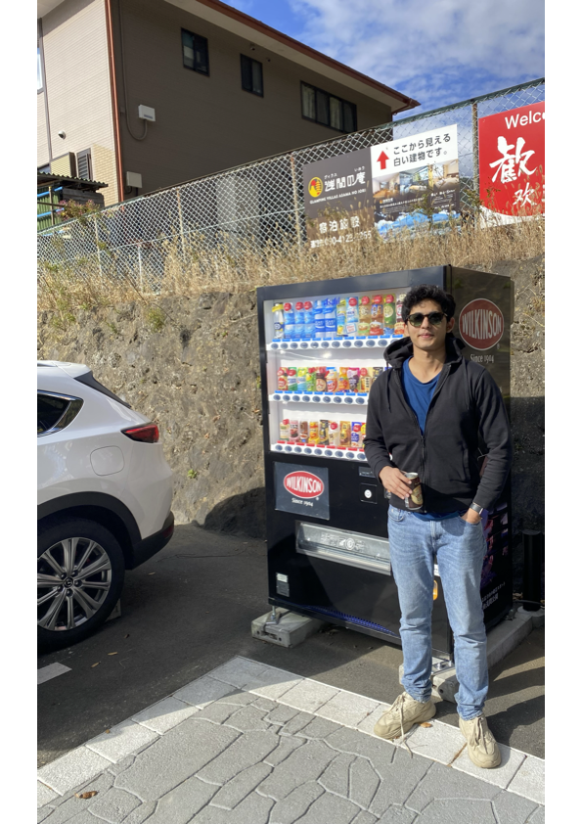
The Team
Emma Hudson
Nada Mashkour
Manuel Chavez
Arnav Chaudhari
B.S. Business Analytics
B.S. Business Analytics
M.S. Business Analytics
M.S. Business Analytics
Advisors: Professor Hall, Marwan Zamamiri, Miguel Maldonado

Slide 3
Agenda
Problem Statement
Project Objective
DOH: Key Understandings
Methodology
Dashboard Demonstration
Next Steps

Slide 4
Problem Statement
As part of New York City’s Data Initiative, the Department of Health (DOH) is looking to enhance its analytics capabilities in the inspection of restaurants and promote the health and safety of NYC residents.

Slide 5
Project Objective
Enhance DOH analytical capabilities by pinpointing trends in NYC's inspection outcomes, crafting a segmented model approach that informs the Department with an interactive dashboard.
Our analysis aims to better inform inspectors what to look for, optimizing the inspection appointment and creating more targeted inspections. Overall, it will be a more efficient system for DOH inspections, acting as a supplementary tool to create an ecosystem of more sanitary conditions in NYC restaurants.

Slide 6
Key Understandings:
NYC DOH Health Inspections
INSPECTION CYCLE
SCORING PARAMETERS
INSPECTION GRADE
All establishments: at least one inspection per year
Receiving a B or C upon reinspection must display two cards: letter grade (B or C) and “letter pending” signage.
Inspectors are given a guide with several health violations to look after from codes 2A-J to 10A-J. Each violation code has a different severity level.
For example, 04M states: Live roaches present in facility. Condition I is 2 live roaches Condition II is 7 live roaches.
Grade is directly dependent on an inspection score.
A: 0-13
B: 14-27
C: 28+

Slide 7
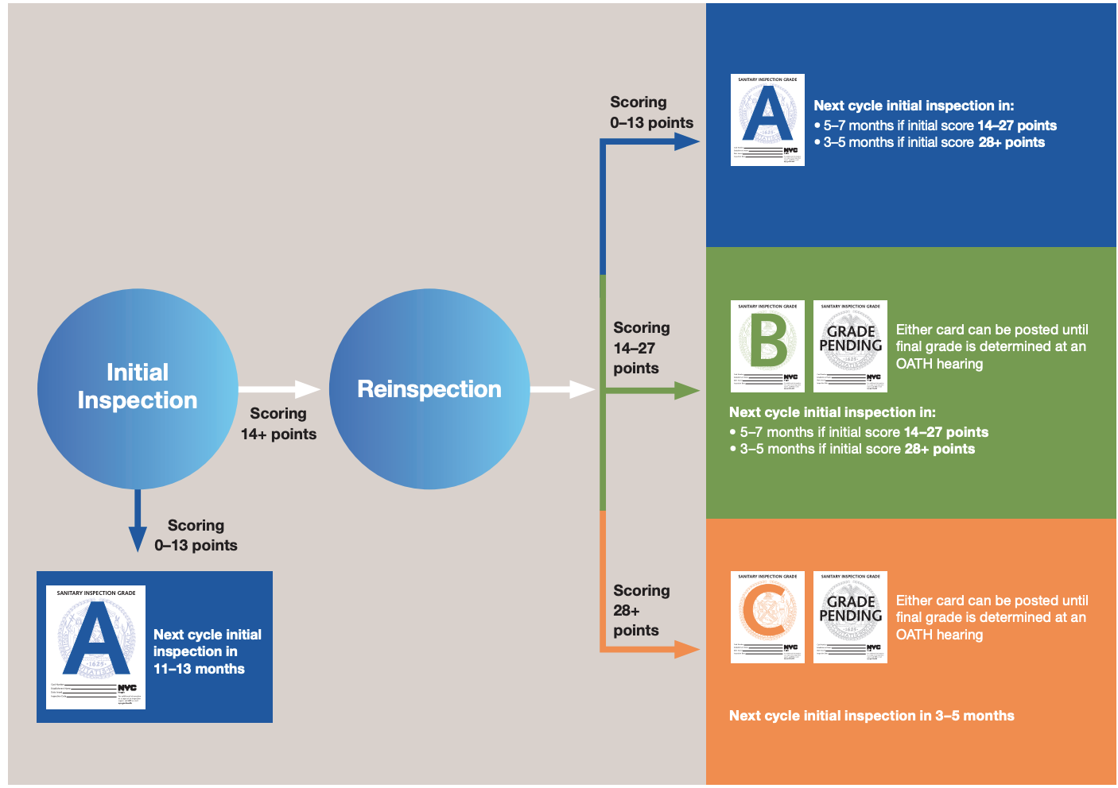
Inspection Cycle Overview - Nyc.Gov, www1.nyc.gov/assets/doh/downloads/pdf/rii/inspection-cycle-overview.pdf. Accessed 22 Apr. 2024.
Notes:
source: https://www.thegreatercollective.com/nyc-dohmh-exploratory-analysis

Slide 8
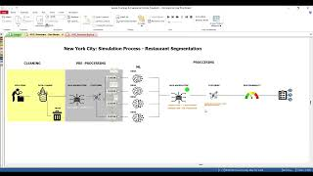
Methodology: Data Preparation

Slide 9
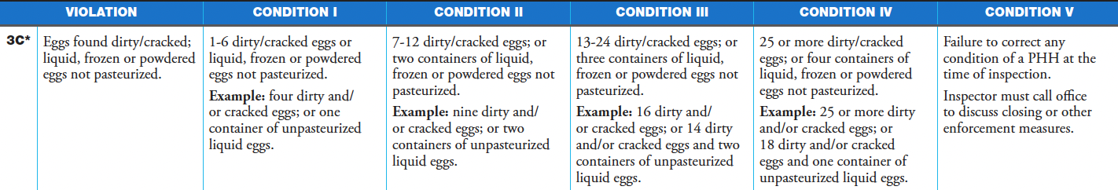
Discovered Limitations
Limited data availability for years prior to 2022
Potential inspector bias present during inspection & data collection process
Limited understanding of severity of the violation: 1-5 rating of severity, but not listed in dataset
As a result, we decided to focus on understanding the severity of the violations by implementing clustering and penalized linear models to see how individual violations
impact the restaurant inspection score.

Slide 10
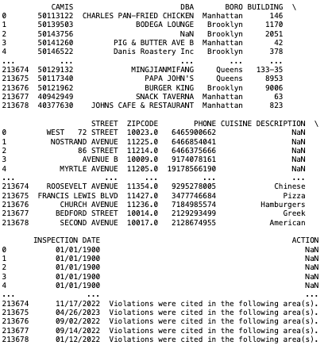
Methodology: Data Preparation
Original Dataset:
213,679 rows, 27 columns
Data spans from 2015-2024, with data recorded in “1900” have an unidentified date
15,625 inspections are recorded in 2023-2024.
Rows with year “2000” removed
Each row identifies a violation per inspection
Independent variables contain information such as: Restaurant ID, Boro, Address, Cuisine Description, Violation Code & Description, Critical Flag (Bool), Score, Grade
Notes:
NADA STARTS HERE

Slide 11
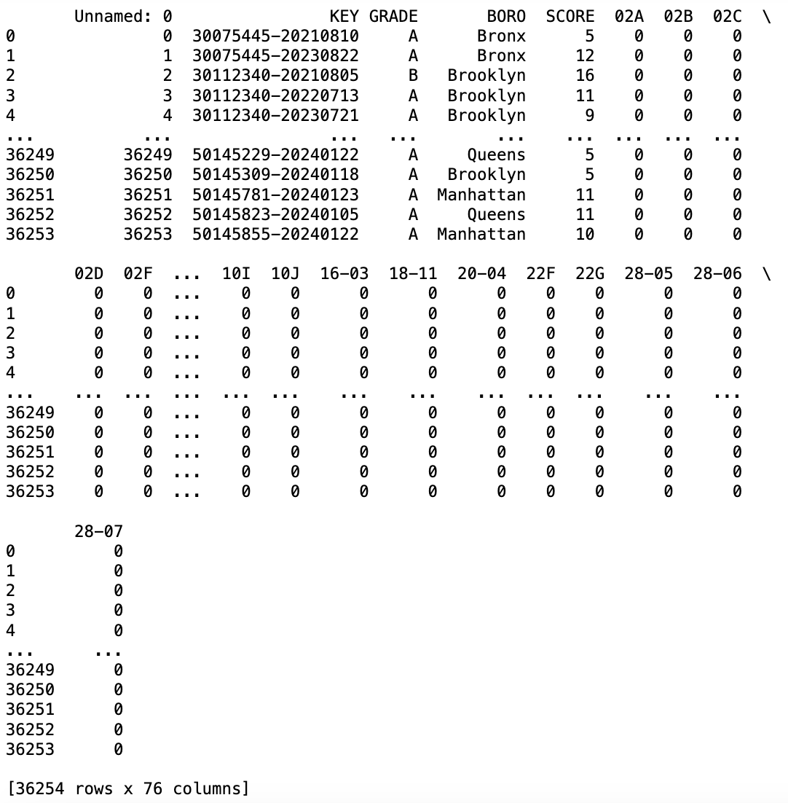
Methodology: Data Preparation
Cleaned/Modified Dataset:
36,254 rows, 76 columns
Columns
Key (RestaurantId -DateOfInspection), Grade, Boro, Score, and dummy variables for all the violations.
Rows
Each row is an inspection completed by the DOH. There are 36,254 rows between years 2015-present.

Slide 12
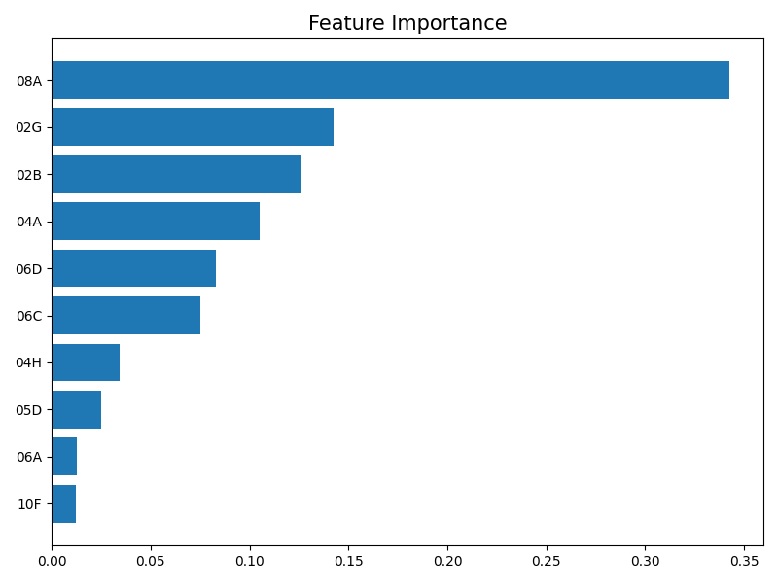
Methodology: Data Insights
Washing facilities not provided
Cold potentially hazardous food not held at 41°F or below
Hot potentially hazardous food not held at 140°F or above
Food Protection Certificate not held by supervisor or manager of food operations
Food contact surface not sanitized; and/or not clean to sight and/or touch
Food not protected from contamination
Food not protected from cross-contamination
Hand washing facilities not provided or not located where required
Food worker does not maintain personal cleanliness
Non-food contact surfaces improperly constructed/maintained

Slide 13
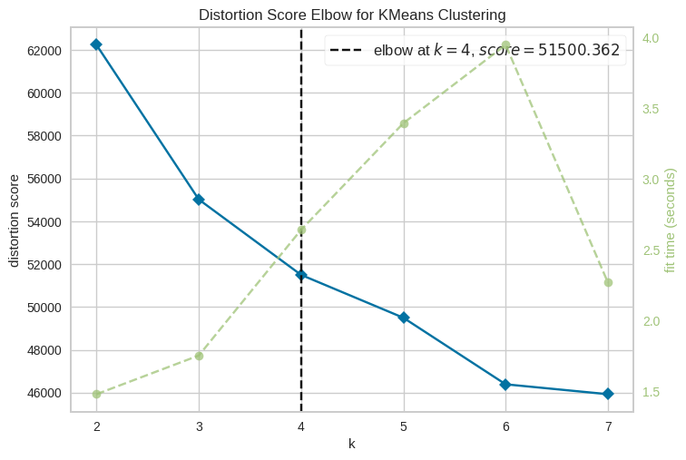
Methodology: Data Pre-Processing
K-Means Clustering
Identify the patterns and relevant features.
Run K-Means Clustering model on cleaned dataset to identify clusters based on violation codes
K-Means Algorithm run on only violation codes
Why? Prior regression models showed high multicollinearity & insignificant test results when including boro & cuisine type
Elbow plot: K=4
Notes:
NADA STOP HERE, Manuel does this slide

Slide 14
Methodology: Cluster Analysis
Cluster 1: “Unsafe Surfaces & Food Temp”
Top 3 violations: Food contact surface not washed, non-food contact surface improperly constructed, hot food items not held at adequate temperature
Cluster 2: “Food Not Protected”
Top 3 violations: Not protected from contamination, non-food contact surface improperly constructed, food contact surface not washed
Cluster 3: “Improper Food Construction & Food Temp”
Top 3 violations: Non-food contact surface improperly constructed, plumbing not properly installed, cold food items out
Cluster 4: “Pests, Mice, Flies”
Top 3 violations: conditions conducive to pests, evidence of mice, filth flies present

Slide 15
Methodology: Modeling
Models Per Cluster:
Ran penalized linear models per each cluster: Linear, Ridge (α=1), LASSO (α=1)
60/40 (train/test) split, by year (test: 2023-2024 data)
Cluster | Score Mean | Linear | Ridge | Lasso
0 | 17.64 | R²=0.86, MAPE=14.44 | MAPE=13.05 | MAPE=34.33
1 | 16.75 | R²=0.96, MAPE=10.03 | MAPE=8.9 | MAPE=35.39
2 | 10.38 | R²=0.92, MAPE=8 | MAPE=7.5 | MAPE=47.20
3 | 9.50 | R²=0.92, MAPE=14.26 | MAPE=10.39 | MAPE=29.86
Notes:
MANUEL STARTS HERE

Slide 16
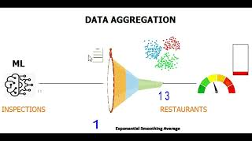
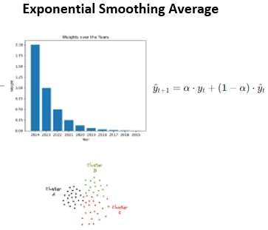
Methodology: Modeling
After Regression Models…
Select the best model per cluster in order to predict the score according to the violations identified during inspection.
Since the data has a time component, training and testing was split based on date of inspection.
Aggregation based on ID Restaurant
Transforms dataset: Each row is now a restaurant

Slide 17
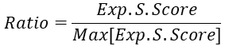
Risk Probability Score Creation
The risk probability score sets a threshold as the Max Exp. Smoothing Score of the aggregate data, in order to identify the risk of each restaurant in the current scenario.

Slide 18
Dashboard Purpose
This dashboard aims to provide DOH inspectors and authorities with a comprehensive view to make informed decisions, allocate resources effectively, and prioritize inspections in areas or restaurants with higher potential health risks. By using the segmented model approach, the Department can better understand prominent violations and trends within restaurants.
Notes:
MANUEL STOPS HERE, ARNAV’S SLIDE

Slide 19
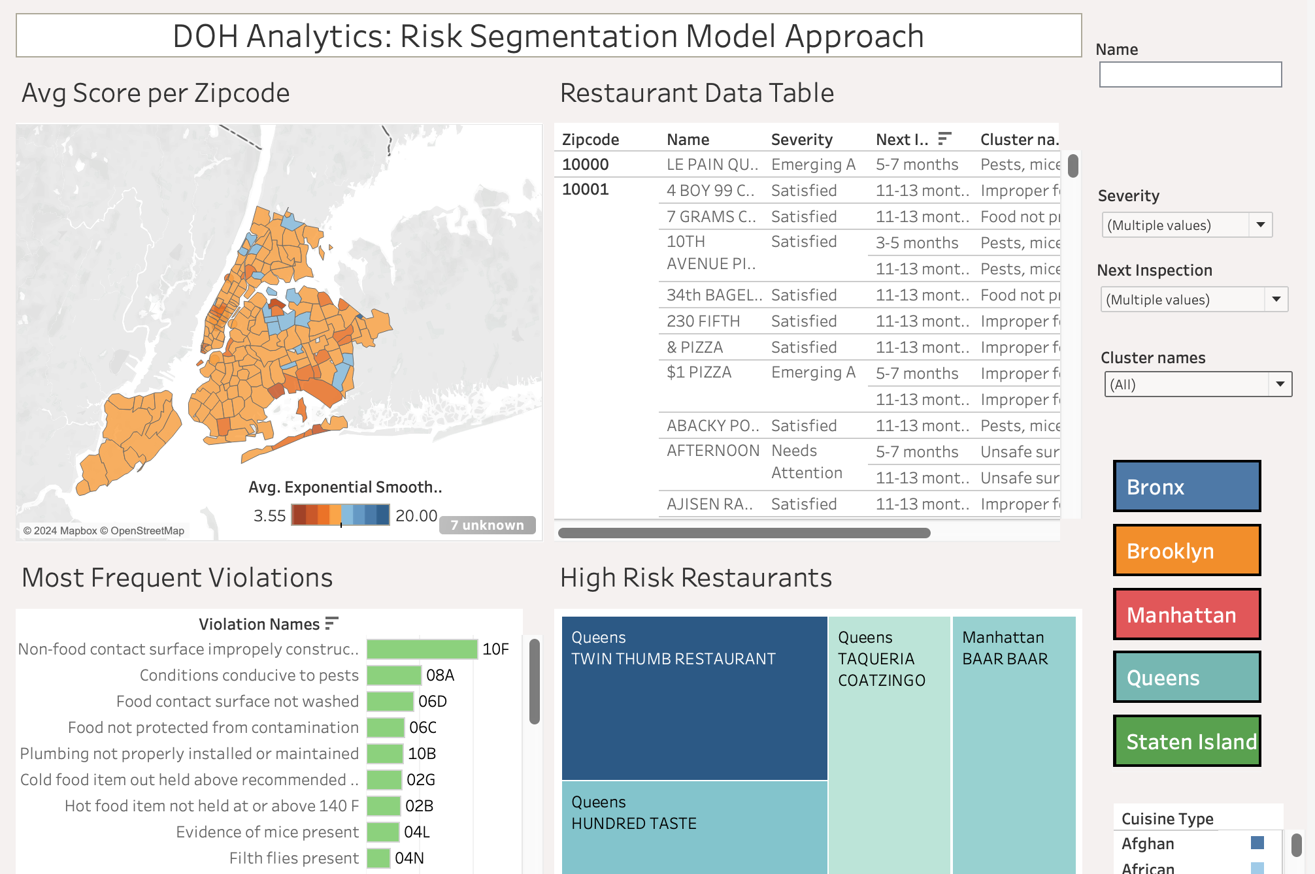
Tableau Dashboard Demo
Notes:
ARNAV

Slide 20
Next Steps
Increasing silhouette score for more accurate clustering results
Implementing visualization for clusters within the dashboard
Bug fixes to the dashboard for smoother interactions
Create a server to allow for real-time data to populate dashboard

Slide 21
Thank You!

Slide 22
Appendix

Slide 23
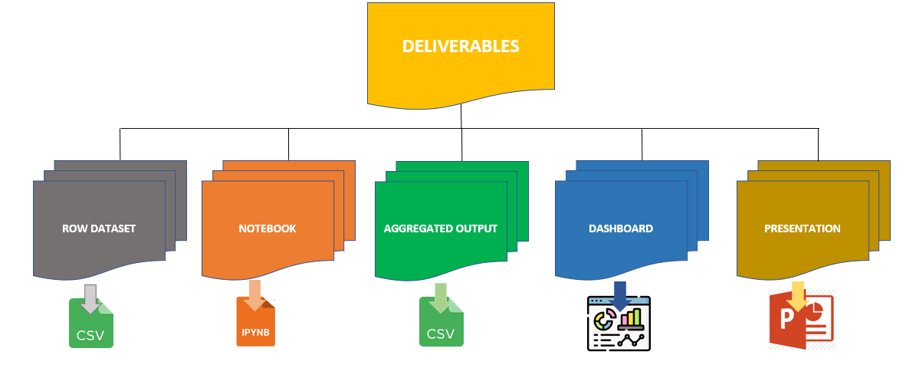
Final Deliverables

Slide 24
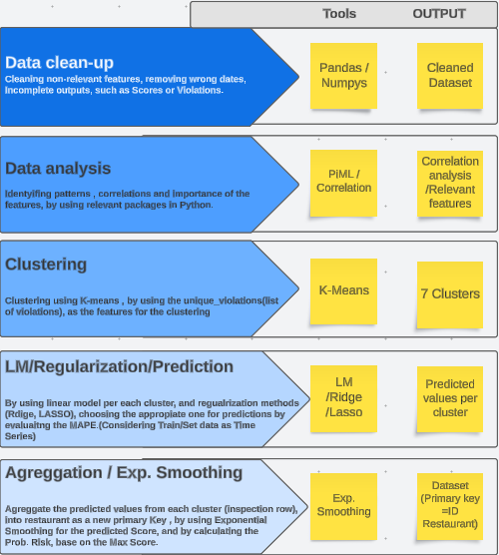
Project
Roadmap

Slide 25
Dashboard Usage
The Geo Map provides an average risk score, facilitating inspectors in pinpointing specific regions for inspection based on risk assessment.
The Restaurant Data Table offers detailed insights into every restaurant within a specific region, providing granular information for thorough analysis and decision-making.
The Tree Map visually highlights the top high-risk restaurants, offering a clear and intuitive way to identify safe dining options within a given area.
The Horizontal Bar Chart quickly convey the top 10 violations, offering a snapshot of the most frequent regulatory issues.
The Dashboard Controller facilitates restaurant filtering by region, severity and cuisine type streamlining the process of focusing on specific geographical areas.
Notes:
MANUEL STOPS HERE

Slide 26
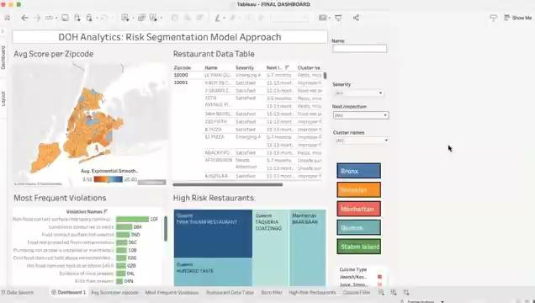
Video Demonstration of Dashboard
Notes:
MANUEL STOPS HERE

Slide 27
Variable Importance Testing
Ran Linear regression to analyze & decide variables to include in modeling
Split by year: Training (2015 - 2022), Testing (2023 - 2024)
Models:
Score ~ Boros + Violation Codes + Cuisine Type variables
Score ~ Boros + Violation Codes [one random removed] + Cuisine Type
Score ~ Boros + Cuisine Type
Correlations between score & mentioned features
All LM had R² = 1, with coefficients extremely small (ex, -1.03e-14)
Majority of p-values insignificant
Overall, models including Boros + Cuisine Type demonstrated extreme overfitting…
The project’s final models will include only Violation Codes due to above results

Slide 28






Resources & Packages Used

Slide 29
Resources & Research
Post-Covid Impact on NYC Restaurant Inspections
NYC DOH: Inspector Blue Book
Research: Data Analysis & Segmentation Methods on Inspection Data

